Slide 1
happiness data
File created on: 12/21/2020 2:08:52 PM

Slide 2
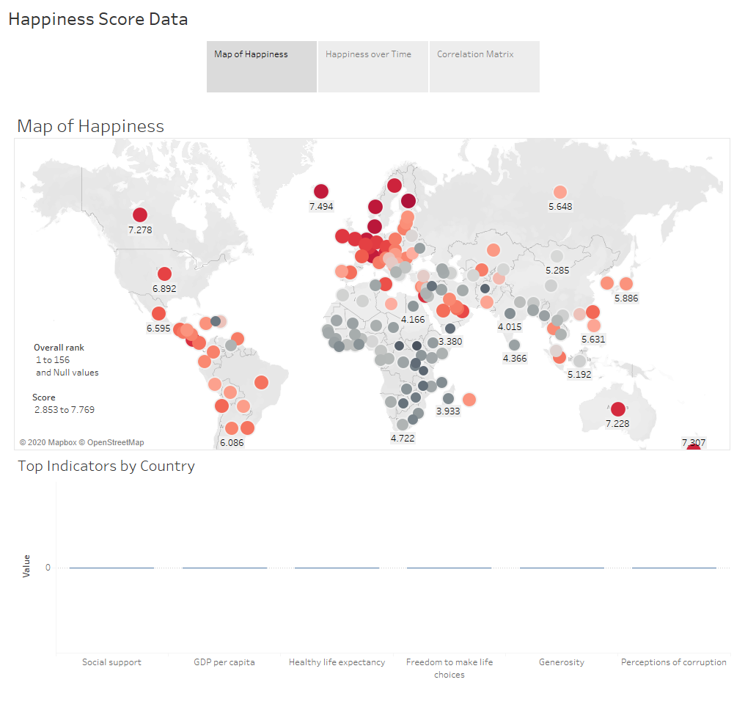

Slide 3
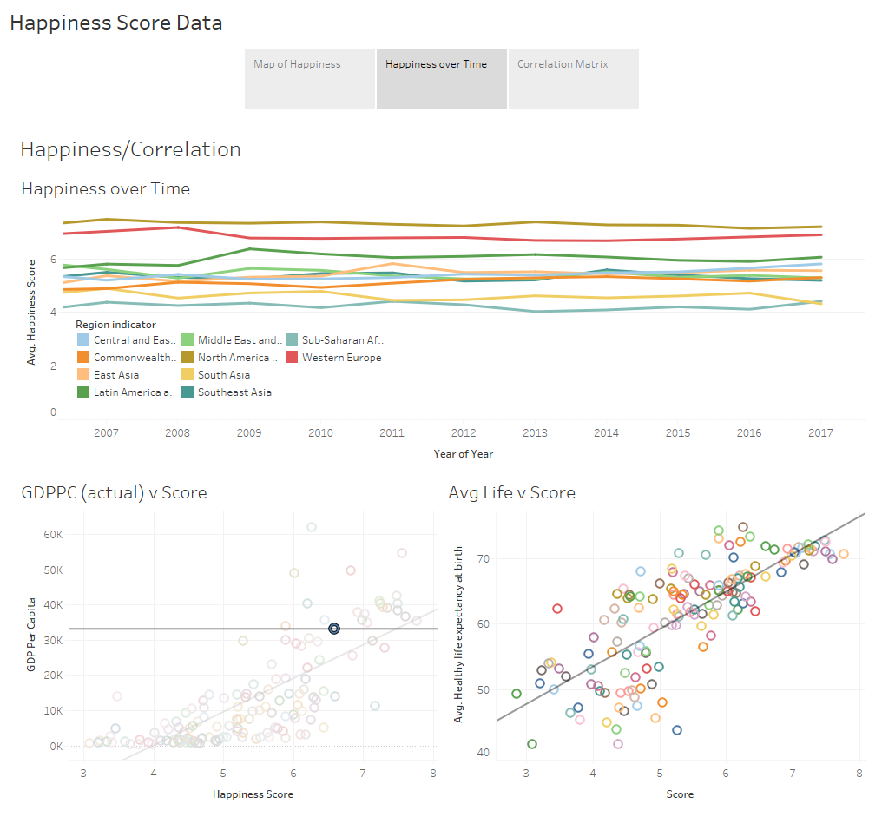

Slide 4
